Slide 1
Implementation and software
Project#1 (5 points)

Slide 2
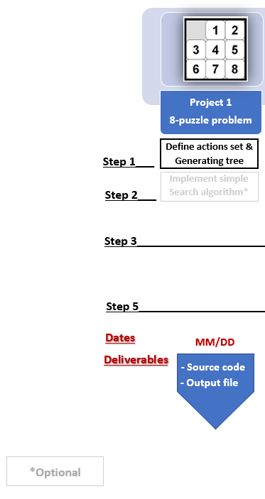
Project 1

Slide 3
Project -1 Description
Find all the possible states of the 8-Puzzle starting from the given initial state. Note that, the states should be unique (no repetitions).
From the initial state of the puzzle, use different moves in all the directions to generate new states, check the validity of the newly generated node.
You should use Python for programing
Use the Brute Force Search(BFS) to find the path to reach the goal state using the possible states of 8-puzzle.
Implement back tracking to find the plan to solve the problem

Slide 4
Example

Slide 5
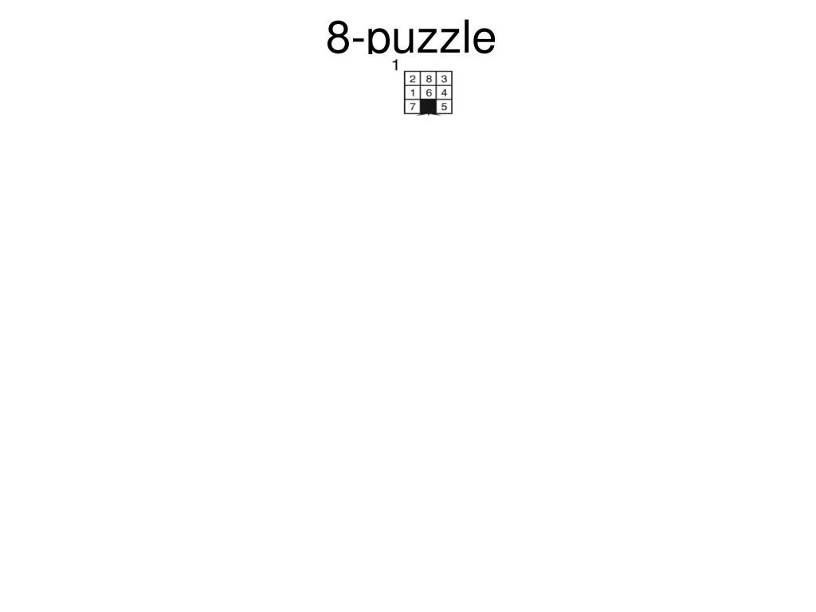

Slide 6
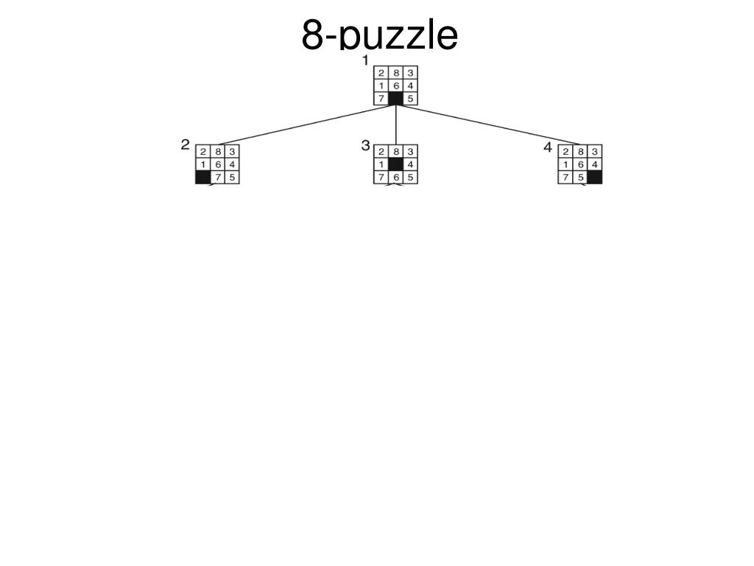

Slide 7
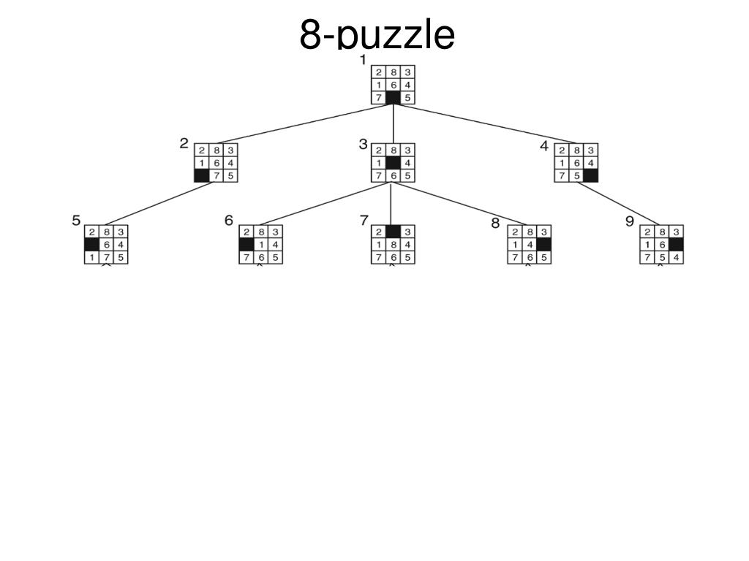

Slide 8
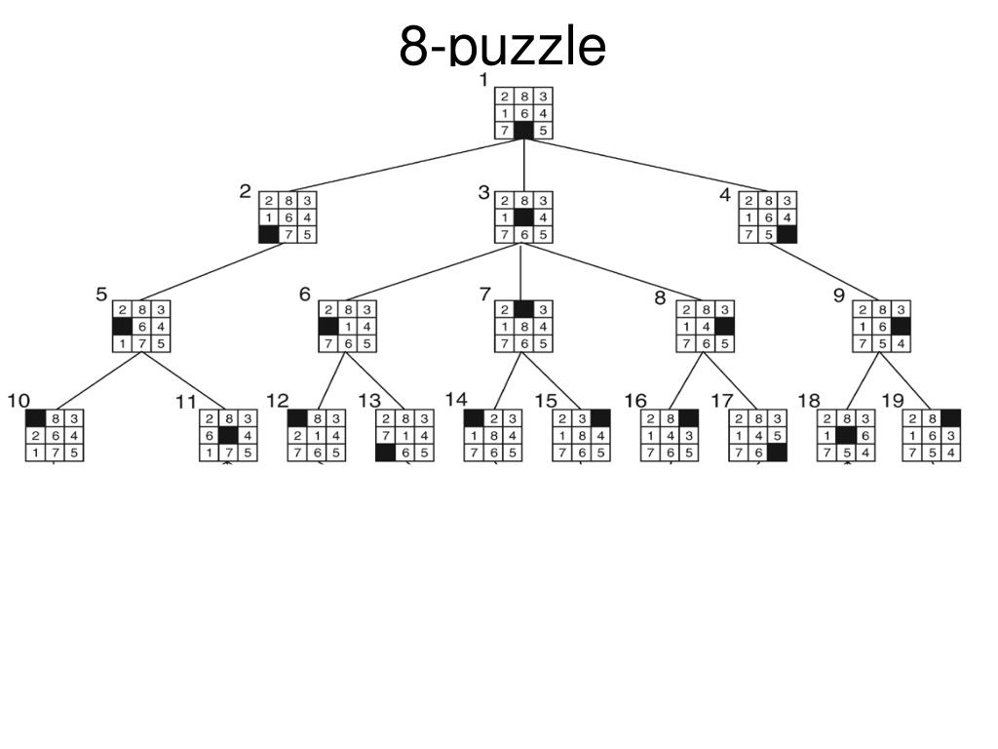

Slide 9
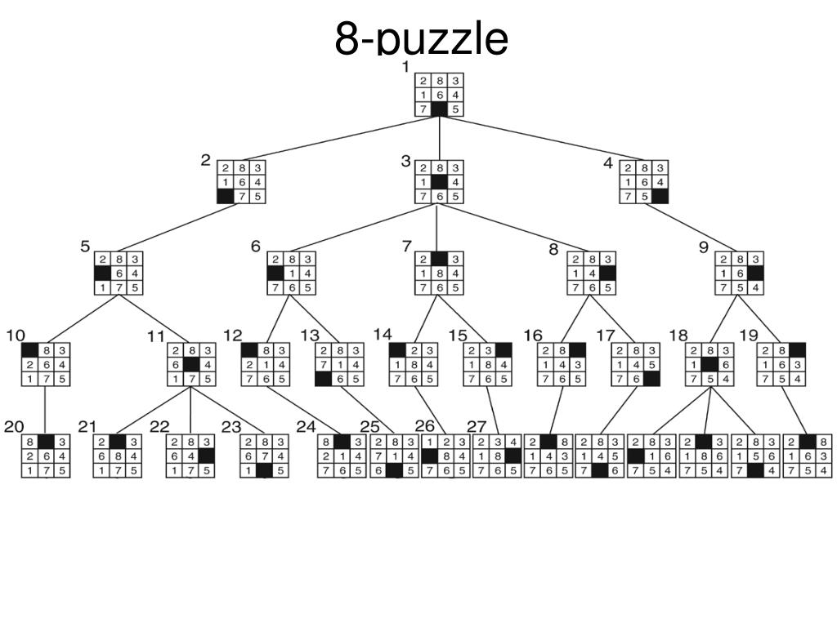

Slide 10
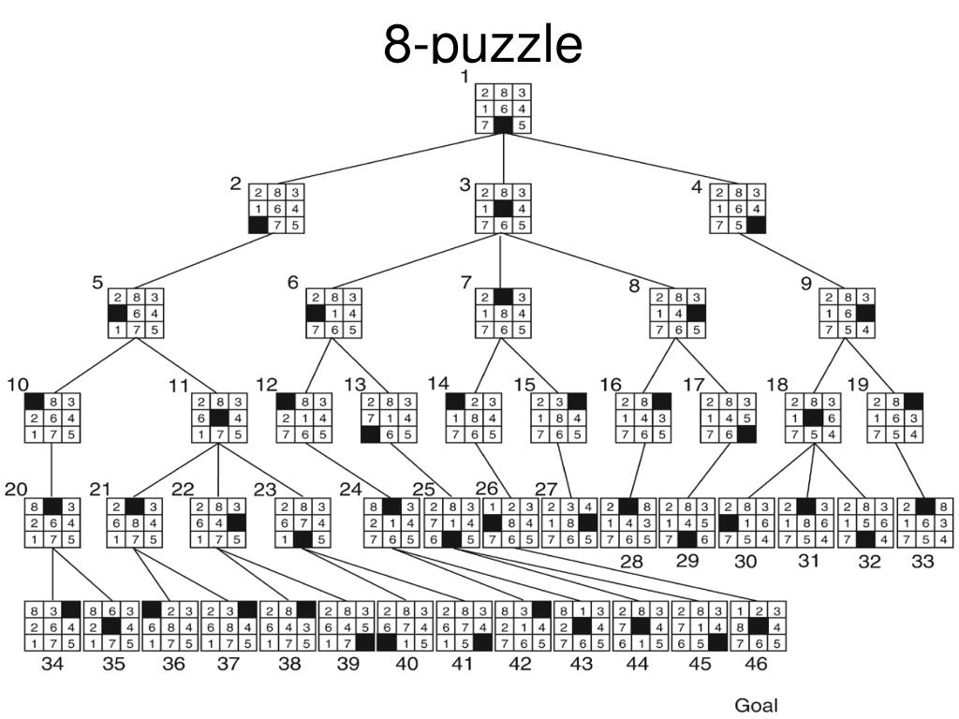

Slide 11
Flow chart
Start
Get the initial node from user
Save node information using a data structure
Apply actions to blank tile to generate new nodes
Node already exists in the data structure
Yes
No
No
Add new node and the parent node to data structure
Is the new node the goal node?
Yes
Back track to find the path
Print path
end

Slide 12
Suggested Parameter Names
Information to be stored in the data structure for each node:
Node_State_i: The state of node i is represented by a 3 by 3 matrix, for example [ 1 2 3; 4 5 6; 7 8 0].
Node_Index_i : The index of node i
Parent_Node_Index_i: The index of parent for node i.

Slide 13
1-First Step
You should first select a data structure type to save your generated nodes.
There are different types of data structure that could be used. The type of data structure is optional.

Slide 14

Data structure in PYTHON
Review the “list” and “dictionary” data structures for python in the following link
1) Learn Python - Full Course for Beginners [Tutorial] (Links to an external site.)
2) https://www.youtube.com/watch?v=tw7ror9x32s
3) https://www.linkedin.com/learning/learning-python-2/welcome (Links to an external site.)
4) https://www.linkedin.com/learning/programming-foundations-data-structures-2/understand-data-structures (Links to an external site.)
5) https://www.linkedin.com/learning/python-data-structures-stacks-queues-and-deques/python-data-structures-primer (Links to an external site.)
6) Textbook: http://do1.dr-chuck.com/pythonlearn/EN_us/pythonlearn.pdf (Links to an external site.)

Slide 15
2. Step two
Write a function that given the state of the current node in the 8puzzle problem, calculates the location of the blank tile in the 3 by 3 matrix and returns the output as a pair, (i,j). Where 0<i<4 and 0<j<4.
You should use two For loops to check for the location of the blank tile. Call this function BlankTileLocation
[i j] = BlankTileLocation(CurrentNode);
% Find the location of the blank tile

Slide 16
3. Step three
Write 4 subfunctions to move the blank tile in 4 different directions
[Status, NewNode] = ActionMoveLeft(CurrentNode);
% Moves blank tile left, if possible
[Status, NewNode] = ActionMoveRight(CurrentNode);
% Moves blank tile right, if possible
[Status, NewNode] = ActionMoveUp(CurrentNode);
% Moves blank tile up, if possible
[Status, NewNode] = ActionMoveDown(CurrentNode);
% Moves blank tile down, if possible

Slide 17
4. Step four
Write a new subfunction that adds the current node to Matrix_8puzzle_Nodes
[Nodes, NodesInfo] = AddNode(NewNode);
% Function also checks whether node is new or not

Slide 18
5. Step five
Write a subfunctions (generate_path) that uses back tracking to find the path between the initial node and final node.

Slide 19
Additional Notes
Each test case will be allowed to run for a maximum of two hours to be considered for evaluation, i.e. given an initial node, the eight puzzle should be solved within this time.
Randomly 20-25 students will be selected who need to explain their code during TA office hours.

Slide 20
Due Date and Deliverables
Due date: February 21 , 11:59 p.m.
Submit deliverables on Canvas & GitHub.
Deliverables:
Source code (Should be a python file)
Output textfile to be generated from the code: Nodes, NodesInfo and nodePath.
A text file that explains how to run the program.
Folder Name (zip) : proj1_firstname_lastname

Slide 21
GitHub and README
GitHub
Well commented code
Frequent detailed commits, i.e. commits should have messages. For example - “ Added function to find the blank tile location”
The link (made public) should be uploaded as comments with your submission.
ReadMe
Instructions to run the code, step by step.
Explicitly mention the libraries used in your code

Slide 22
Output textfile to be generated from the code
Textfile 1:
Name: nodePath.txt
The elements are being stored column-wise, i.e. for this state 1 4 7 2 5 8 3 6 0, the eight puzzle state is
1 2 3
4 5 6
7 8 0
The order of the states should be from start node to the goal node.
Textfile 2:
Name: NodesInfo.txt
First column: Node Index
Second Column: Parent Node Index
Textfile 3:
Name: Nodes.txt
All the explored states should be present in the format of nodePath.txt
Look at the sample text files uploaded for more clarity.

Slide 23
Code Visualization
A python file has been provided (plot_path.py) which will help with the visualization of the output text file.
The python file reads the text file (nodePath.txt) generated by your code.

